Slide 1
Data Link Control

Slide 2
11-1 FRAMING
The data link layer needs to pack bits into frames, so that each frame is distinguishable from another. Our postal system practices a type of framing. The simple act of inserting a letter into an envelope separates one piece of information from another; the envelope serves as the delimiter.
Topics discussed in this section:
Fixed-Size Framing
Variable-Size Framing
11.<number>

Slide 3

Figure 11.1 A frame in a character-oriented protocol
11.<number>

Slide 4

Figure 11.2 Byte stuffing and unstuffing
11.<number>

Slide 5

Note
Byte stuffing is the process of adding 1 extra byte whenever there is a flag or escape character in the text.
11.<number>

Slide 6

Figure 11.3 A frame in a bit-oriented protocol
11.<number>

Slide 7
Note
Bit stuffing is the process of adding one extra 0 if 011111 is encountered in data, so that the receiver does not mistake
the pattern 0111110 for a flag.
11.<number>

Slide 8

Figure 11.4 Bit stuffing and unstuffing
11.<number>

Slide 9
11-2 FLOW AND ERROR CONTROL
The most important responsibilities of the data link layer are flow control and error control. Collectively, these functions are known as data link control.
Topics discussed in this section:
Flow Control
Error Control
11.<number>

Slide 10
Note
Flow control refers to a set of procedures used to restrict the amount of data
that the sender can send before
waiting for acknowledgment.
Aka: Don’t overwhelm the receiver!
11.<number>

Slide 11
Note
Error control in the data link layer is based on automatic repeat request, which is the retransmission of data.
11.<number>

Slide 12
11-3 PROTOCOLS
Now let us see how the data link layer can combine framing, flow control, and error control to achieve the delivery of data from one node to another.
11.<number>

Slide 13

Figure 11.5 Taxonomy of protocols discussed in this chapter
11.<number>

Slide 14
11-4 NOISELESS CHANNELS
Let us first assume we have an ideal channel in which no frames are lost, duplicated, or corrupted. We introduce two protocols for this type of channel.
Topics discussed in this section:
Simplest Protocol
Stop-and-Wait Protocol
11.<number>

Slide 15

Figure 11.6 The design of the simplest protocol with no flow or error control
11.<number>

Slide 16
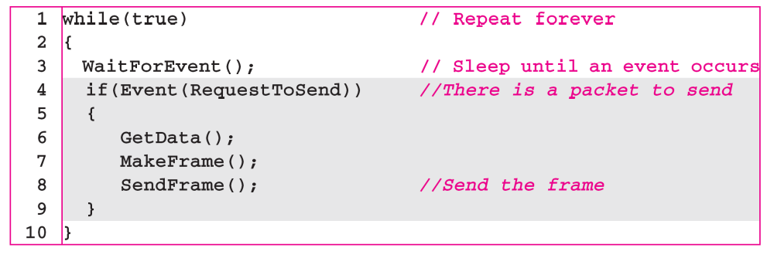
Algorithm 11.1 Sender-site algorithm for the simplest protocol
11.<number>

Slide 17
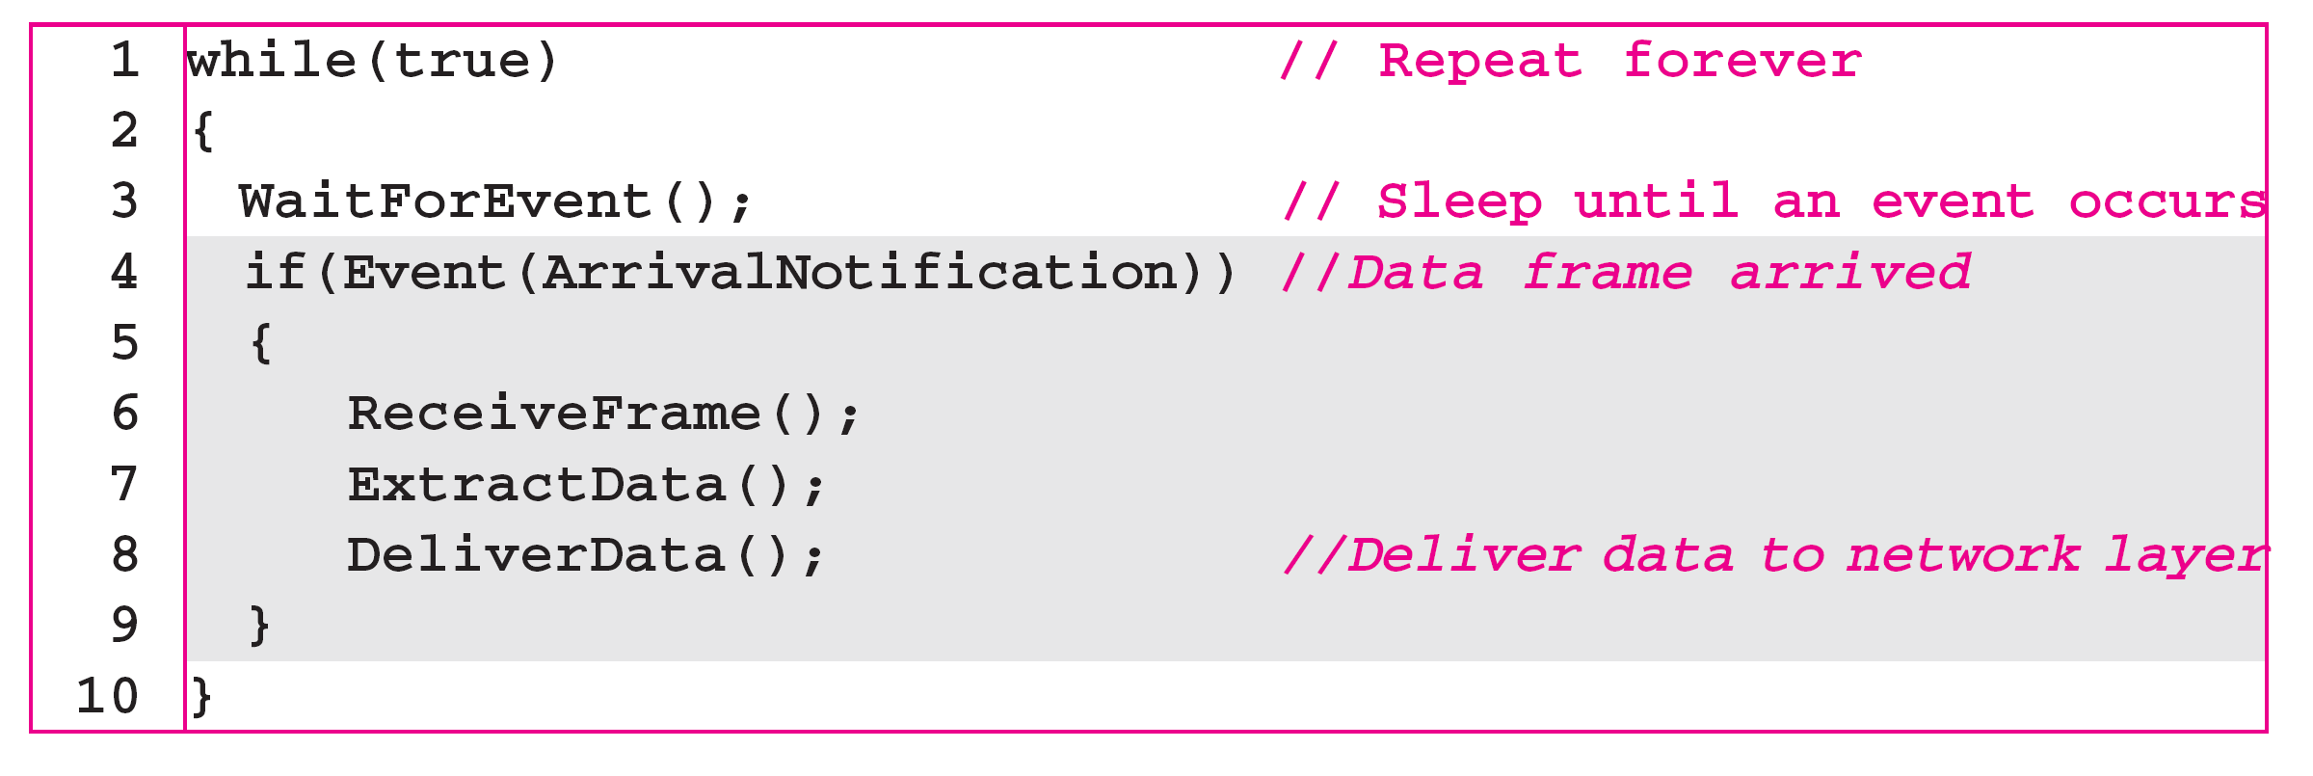
Algorithm 11.2 Receiver-site algorithm for the simplest protocol
11.<number>

Slide 18

Figure 11.7 Flow diagram for Example 11.1
11.<number>

Slide 19

Figure 11.8 Design of Stop-and-Wait Protocol
11.<number>

Slide 20
Algorithm 11.3 Sender-site algorithm for Stop-and-Wait Protocol
11.<number>

Slide 21
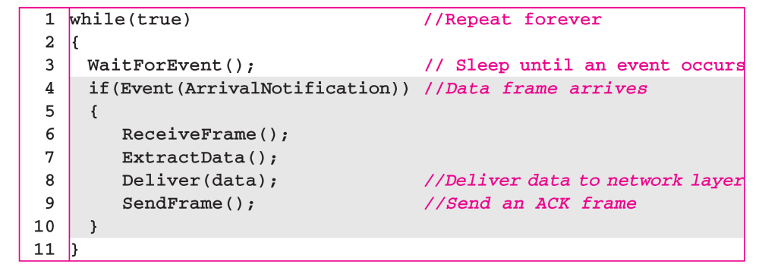
Algorithm 11.4 Receiver-site algorithm for Stop-and-Wait Protocol
11.<number>

Slide 22

Figure 11.9 Flow diagram for Example 11.2
11.<number>

